Slide 1
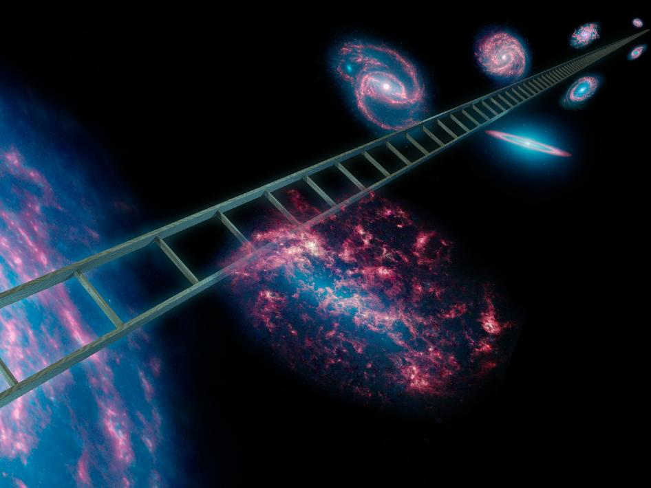
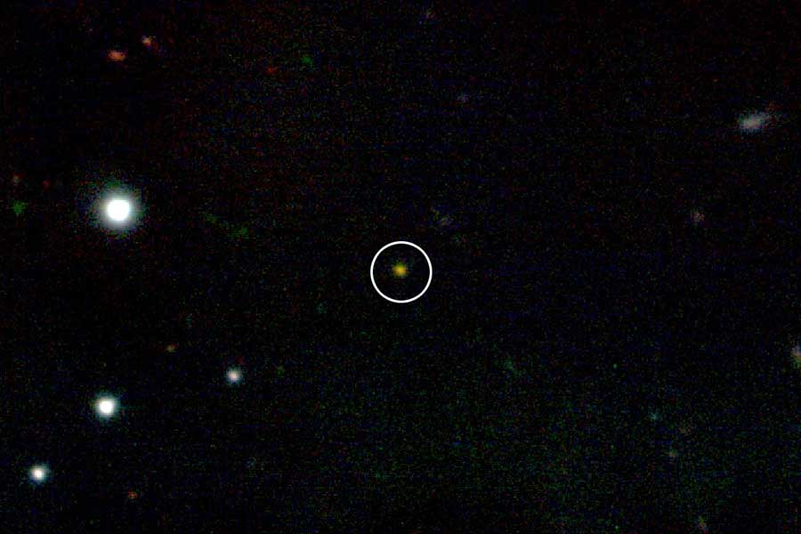

The Cosmic Distance Ladder
Where it takes us and how
Alankar Kotwal
EE, IITB
Earth
Notes:
Hi, undoubtedly the topic is the CDL. I’m ASK, 4rd year EE. In the spirit of the talk today, and my love of astronomy in general: I’m replacing IITB by Earth.
Evolution from watching stars to watching things in the sky, how far. In this conquest: Earth to GRB 090423: 13 billion light years. Wouldn’t claim we’ve reached end of ladder yet.
Will take you right through from Kepler to the research project I did last summer!

Slide 2
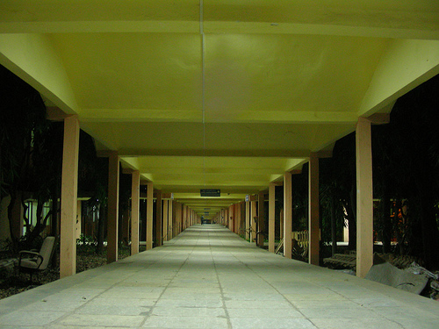
Distances in Astronomy are BIG!
Distances measured by their effects, not by a ruler!
Notes:
Judging by the number of times I said million, huge distances!
Length of Infinite Corridor: 400m. Walk (irritating!) across Infi 375 million times to reach the sun. Will take a man 30 million hours = 3.4k years to complete @ 5km/h
No rulers! Take the object that you want to range, find out any ‘effect’ from that object whose ‘observables’ change with distance: observe these observables and get distance back! Physics and Statistics.

Slide 3

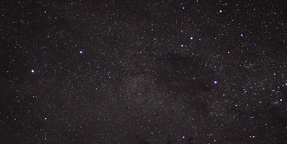
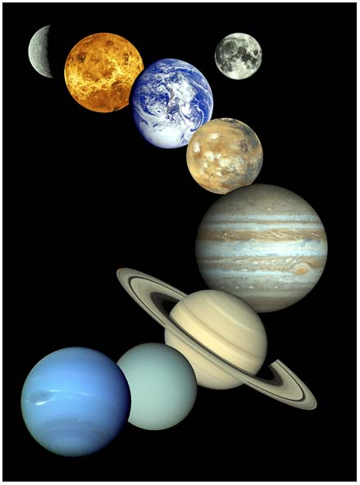
Why Ladder?
Decreasing accuracy, in general
Notes:
Notice I’ve been calling it ‘ladder’. Why? Turns out:
One method implies distance to Sun: 150 million kilometers.
Helps in saying distance to Alpha Cen: 39.92 million million kilometers.
Further helps in saying distance to Betelgeuse: 6.14 million million million kilometers, a fairly faraway star.
More up the ladder, more ‘unsure’, in general. Best we can do.

Slide 4

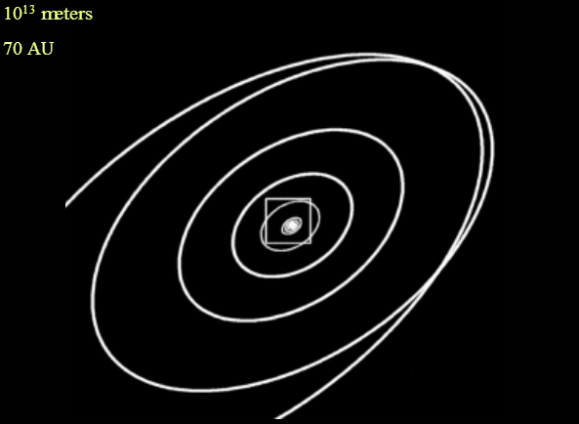


Direct Measurement
$$\frac{T^{2}}{R^{3}}= \frac{4π^{2}}{GM}$$
1 au
Radar => Distance to a few cm!
Notes:
At the base of the ladder: nearest objects! Precise orbit measurements possible (mention Tycho Brahe, modern astrometry satellites). Kepler’s law, Sun center => AU ‘scale’. Max elongations Getting the AU? Venus transits! Modern methods => centimeter level accuracy. Example of how knowing the physics of the system provides us with a method of ranging. Works for solar system objects.

Slide 5
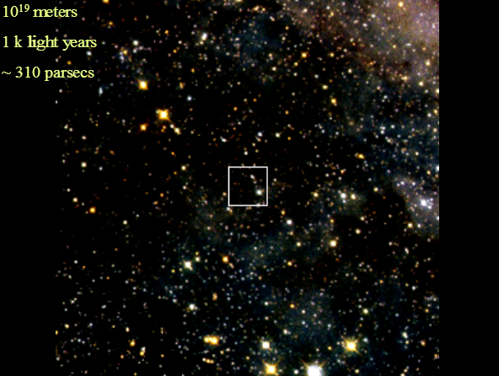
Beyond the Solar System
1 arcsec
1 pc
Notes:
Things too far away for light to return in any reasonable time! Return to geometry tricks, remember Venus transit, except that we do stuff twice the earth’s orbit far. How far? Depends on measurement capability! ~100 pc. Now what do you see here? No structure! We haven't even reached the entire Galaxy yet.

Slide 6
Moving Clusters
Notes:
Though primarily interesting historically, my favorite slide, beautiful example of how ingenious use of trigonometry can give us awesome results.
Observe movements of clusters of stars in time. Hyades cluster a good example. 40pc

Slide 7

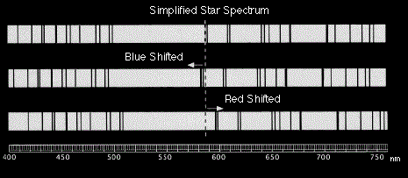
Far beyond
Notes:
Beyond this distance, ‘movement’ because of earth’s own movement is undetectable. What options? Their ‘own’ movement! Doppler effect. Redshifts, angular velocity estimation. Moving cluster, statistical parallax, ‘expansion’ parallax, so on. Extent? We’ll see, this is extremely useful even at distances much larger than the scale right now.

Slide 8
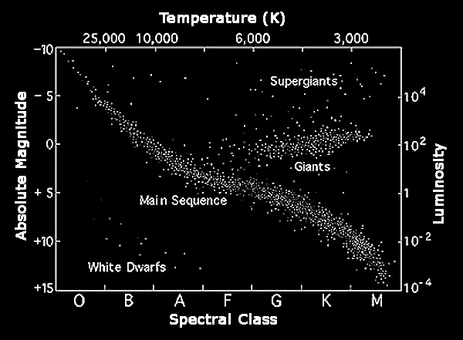
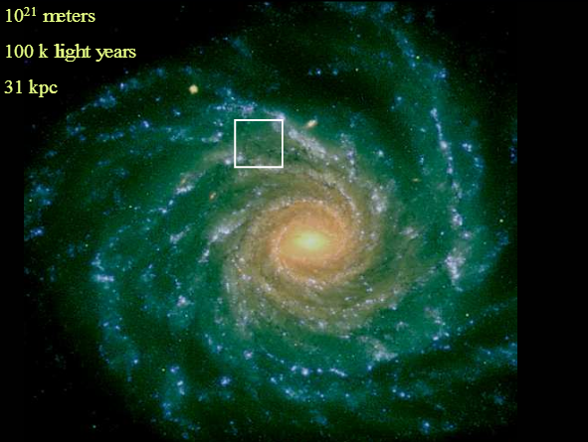
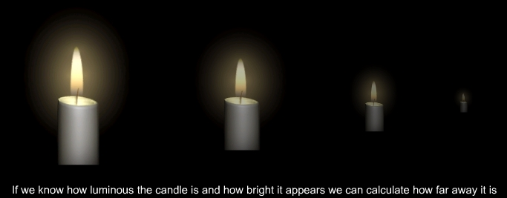
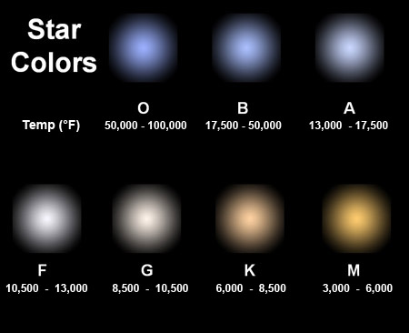
Let there be some light
r
L
R
Notes:
Up to now amount of light not considered. How does light behave with distance? No reason for more light to go in one direction or the other => uniform! Light per unit ‘area’. Guess ‘intrinsic’ light => distance.HR Diagram and ‘color’. Astronomers’ definition. Spectroscopic ‘parallax’. ~10 kpc stars. Galactic scale!

Slide 9
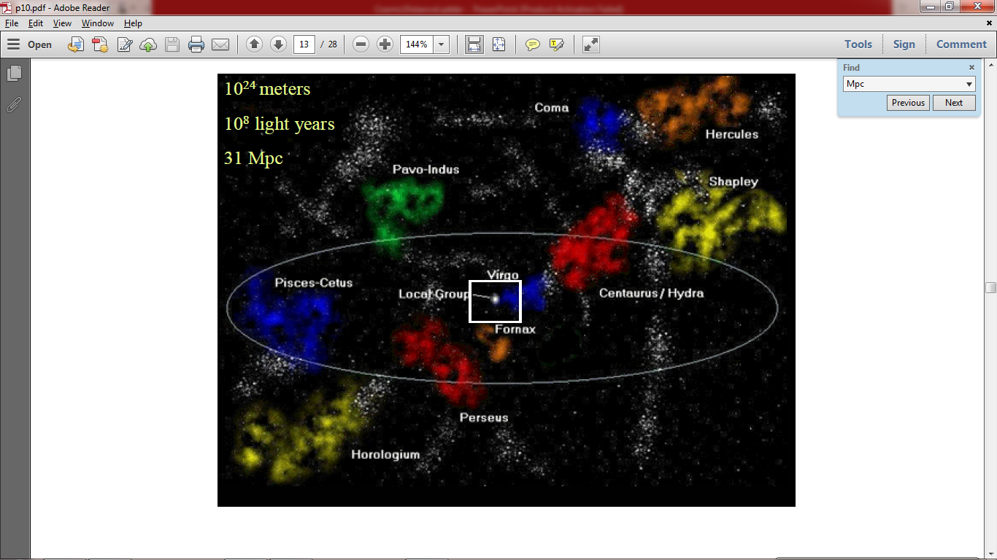
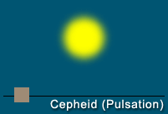

What next?
Previous method again!
$M_{v}$ = -2.43[log(P)-1]-4.05
Notes:
Simple physics upto now. More out into the universe => lesser understood physics. Statistics! ‘Distance indicators’. ‘Standard Candles’. Certain class of pulsating stars, observed that that period of pulsation related to the amount of light they give out. Farthest Cepheid yet found ~30Mpc. At this scale, nearest galaxy clusters.

Slide 10

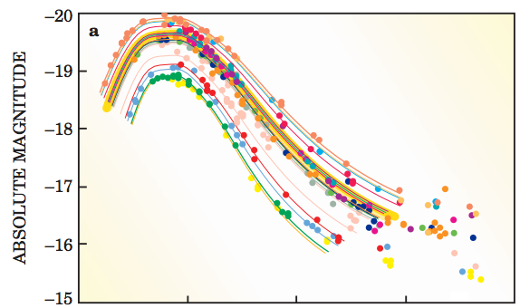
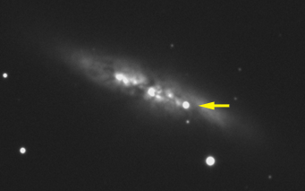
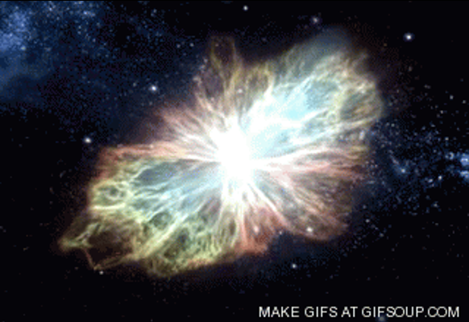
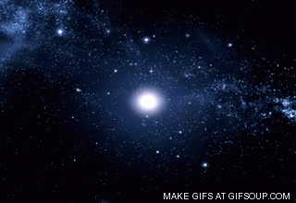
Supernovae!
Credits: Saul Perlmutter: Supernovae, Dark Energy, and the Accelerating Universe http://supernova.lbl.gov/PDFs/PhysicsTodayArticle.pdf
Notes:
(M82) Another ‘standard candle’. Specific type 1A (H/Si absorption features). => White dwarf (nearly dead) star in a binary getting more mass & collapsing. ‘Peak’ amount of light constant. Ejecta assumed spherically symmetric, Doppler and angular velocity. One of the best ways of measuring distances, even on cosmological distance scales (brightness)! One of the best pieces of evidence for Big Bang Cosmology. Why every astronomer wants Betelgeuse to explode. What's the best way to troll an astronomer?

Slide 11
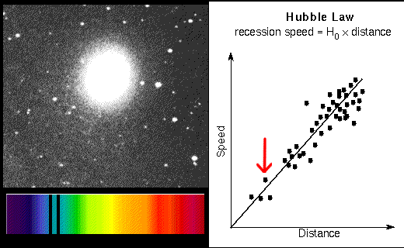
Extreme Distances
Credits: http://astro.wku.edu/astr106/Hubble_intro.html
Notes:
The realization that we don’t have a ‘special’ place in the universe leads us to Hubble’s Law. Discovered much earlier than the theoretical explanation. Determination of constant from ‘nearby’ galaxies from standard candles!

Slide 12
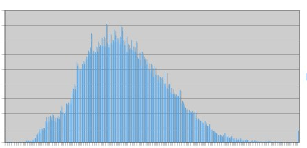
Velocity Dispersions
Notes:
Elliptical galaxies. Plot ‘mass’ of galaxy having a particular velocity against the velocity. Width and absolute magnitude: Faber-Jackson relation.

Slide 13
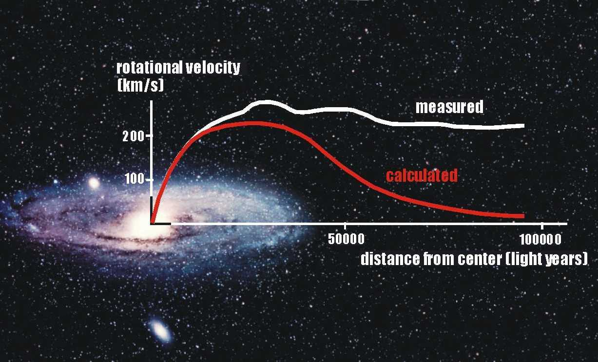
Rotation Curves
Notes:
Plot of rotation velocity of a galaxy with respect to its center. Relation for spiral and lenticular galaxies between the amplitude of this curve and the absolute magnitude. Tully-Fisher Relation.

Slide 14
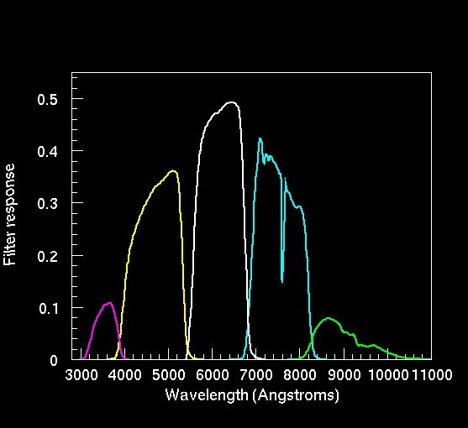
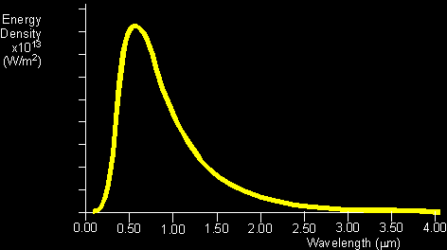
Predictive Methods
Photo-Z
u
g
r
i
z
x
Notes:
All these were ‘definitive’ methods. Means, we knew the exact relation between what we wanted to calculate and what we have. Sometimes, you only know that there’s a relation, there’s no mathematical form. Machine learning! Algorithms like kNN, neural networks, SVMs and so on. Explain classification, regression.

Slide 15
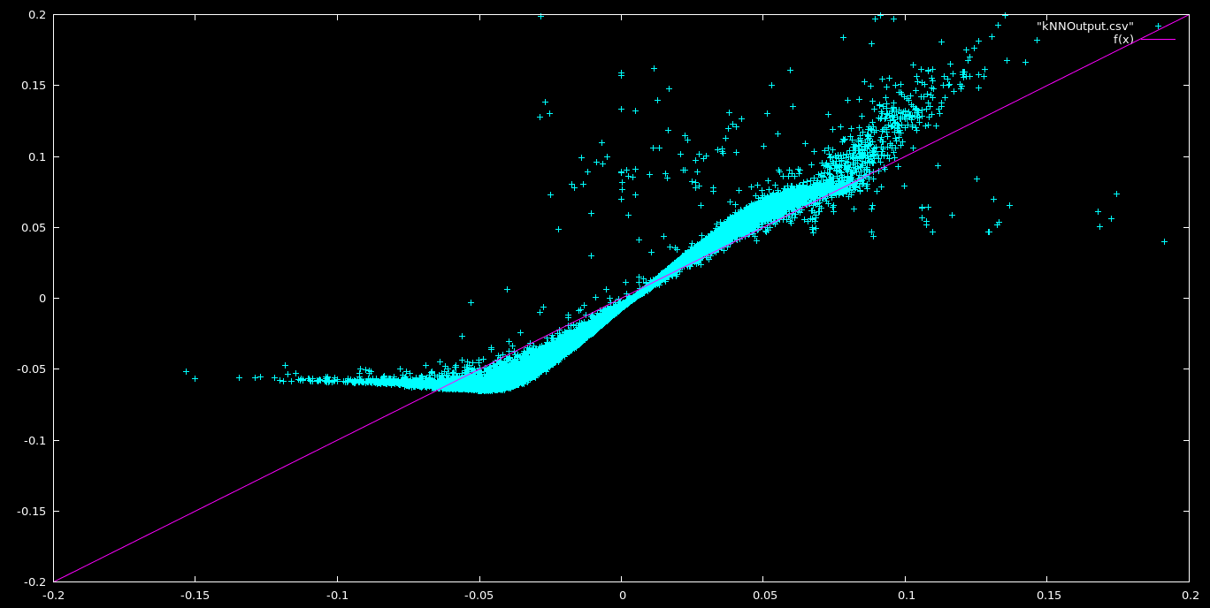
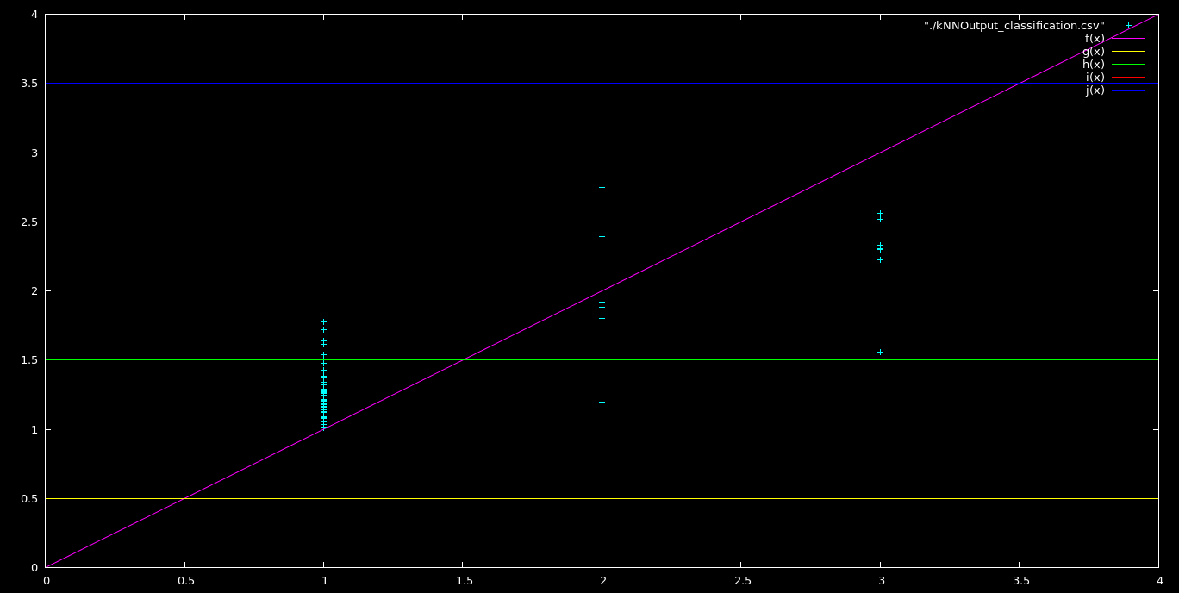
Image Pixel Photo-Z
Notes:
Previous approach used all of the object data over the entire object. Here we use individual pixel data. Advantages? Less noise, background prediction, object deblending.

Slide 16

Astronomers are always coming up with new ways of measuring distances
Notes:
All that said and done, we’re always looking for new ways to estimate distances. An exciting and evolving field!

Slide 17
Questions?
NO aliens, UFOs or God please! ☺
Notes:
☺

